Slide 1
Application of The Derivatives Session 7-9
Course : Calculus
Year : 2015

Slide 2





Find the absolute maximum value and the absolute minimum value, if any, of the function.
2. (a) find the intervals where the function f is increasing and where it is decreasing, (b) find the relative extrema of f, (c) find the intervals where the graph of f is concave upward and where it is concave downward, and (d) find the inflection points, if any, of f.

Slide 3
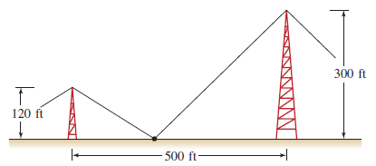
3. Minimizing Length Two towers, one 120 ft high, the other 300 ft high, and standing 500 ft apart, are to be stayed by two wires (among others) running from the top of the towers to the ground between them. Where should the stake on the ground be placed if we want to minimize the length of wire used?

